Slide 1
Fog Mediated Data Sharing for IoT platforms
Sponsor : CMU CyLab, Qarnot Computing Points of contact : Yuan Tian, Emmanuel Owusu Faculty Advisor : Patrick Tague
Team : Aditya Subrahmanyan, Sumana Potturu and Yuehao Yuan

Slide 2
Agenda
Introduction - IoT and data privacy
Project motivation - What is the problem?
Proposed solution - How do we solve it?
Tools and Technologies used
System Design and Implementation
Fog computing service
Privacy-preserving machine learning
Query processing and substitution
Experiments and Analysis
Conclusions
Future work

Slide 3
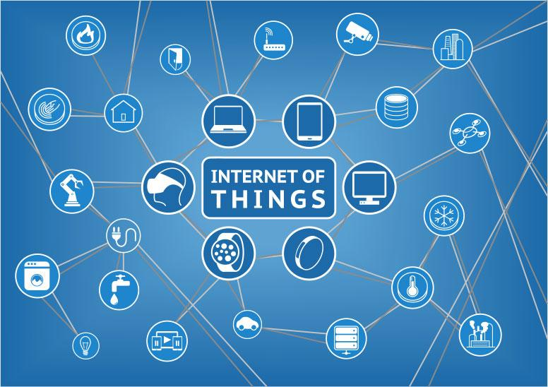
Internet of Things (IoT)
Allows sensing, monitoring and control of objects using network infrastructure
Enables integration of physical world into computer systems and sensory devices
Allows for task automation and user-specific functionalities
Basis for ideas such as Smart Cities, Smart Homes, Smart Energy Management, etc.

Slide 4
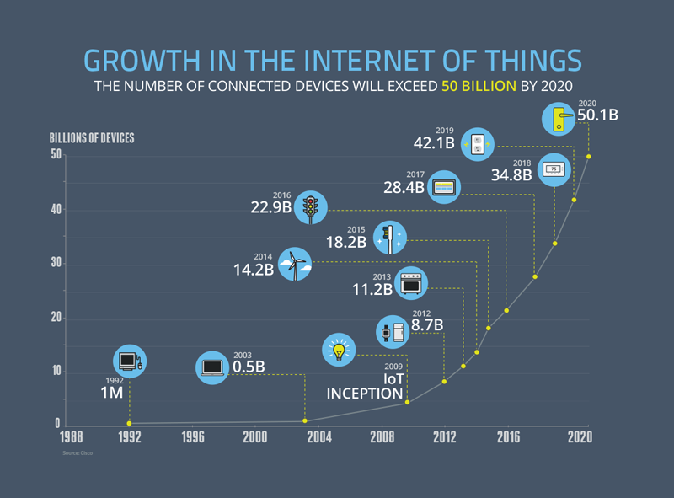
The past, the present and the future

Slide 5
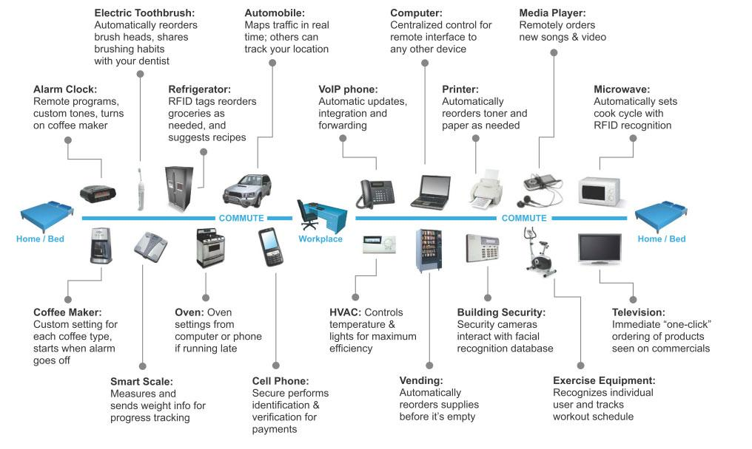
A day in the life of ...

Slide 6
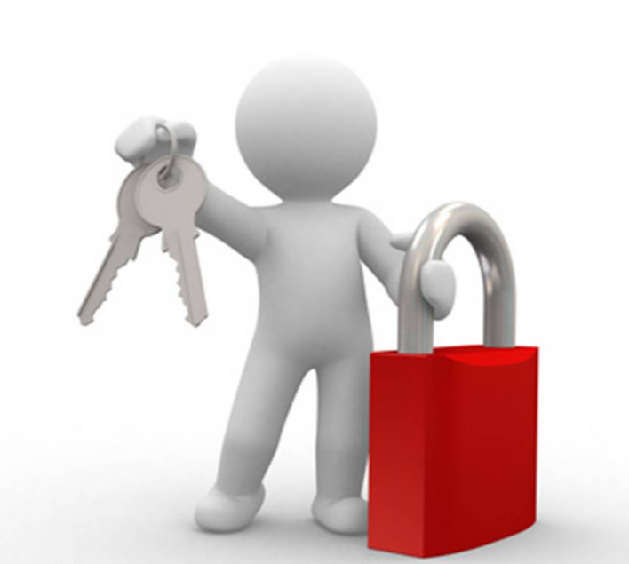
Project Motivation (What?)
Preserve privacy of user/sensed data
IoT devices/sensors generate a lot of potentially sensitive data
Data/privacy breach by potential attacker or provider of application itself
Generate meaningful actions and inferences
Application’s value lost if the data not acted upon automatically
Cannot infer without sufficient useful information
Quicker response and actions by the application
Remote computation and processing is not always desirable
IoT devices cannot all be managed and monitored by admins

Slide 7
Proposed Solution (How?)
‘Deploy a privacy-preserving machine learning model for a fog-computing based data sharing service’
Privacy-preserving machine learning
Prevents adversary from performing a breach of user privacy
Guarantees intended utility of application
Fog computing
Helps avoid remote computation and network overhead
Enables quicker actions on inference/sensed data

Slide 8






Proposed Solution (How?)
Tools and Technologies used
Fog computing service
Privacy-preserving machine learning & Query substitution

Slide 9
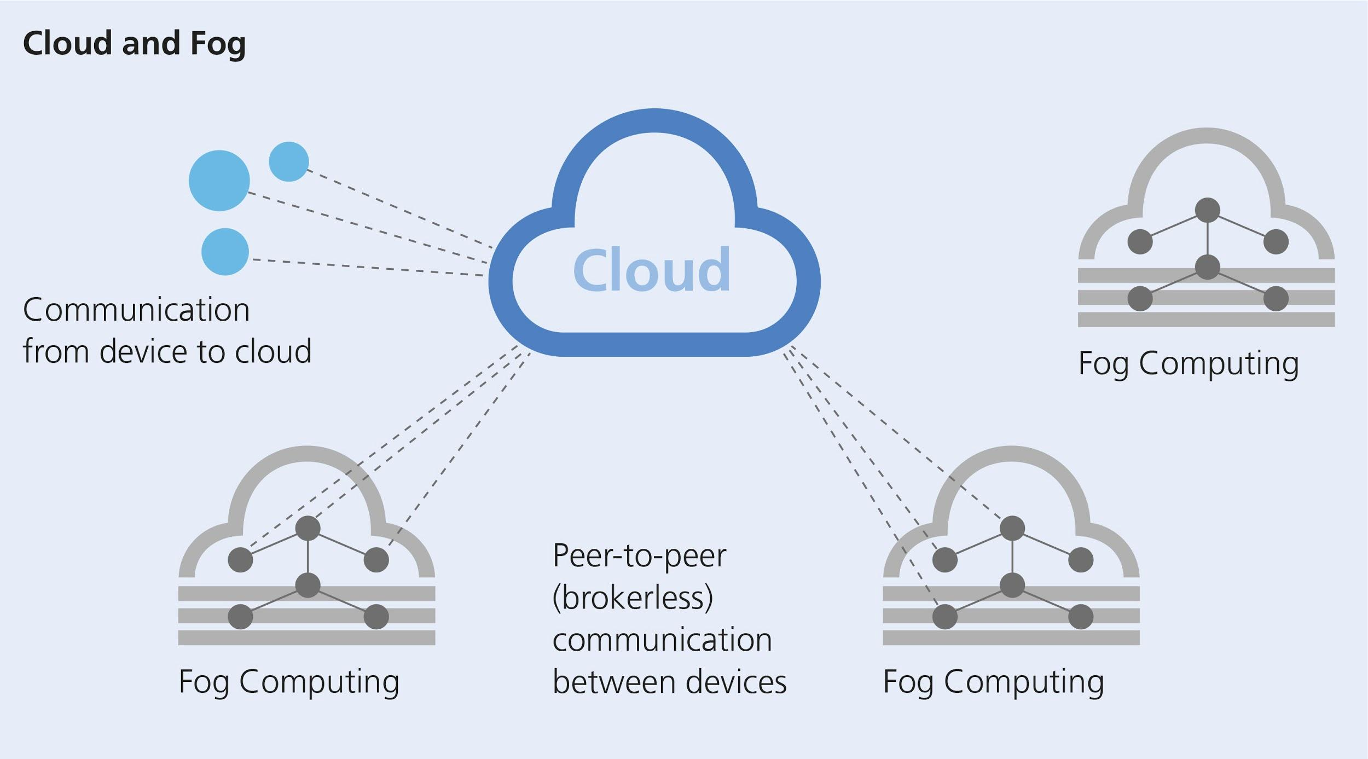
System Design
Fog computing service
Fog computing
Enable computing, networking and storage at the network’s edges
Advantages
Better option than cloud computing for ‘things’ and smaller form factors
Reduces network overhead
Avoids remote data exchange and computation
Quicker actions on sensed data

Slide 10
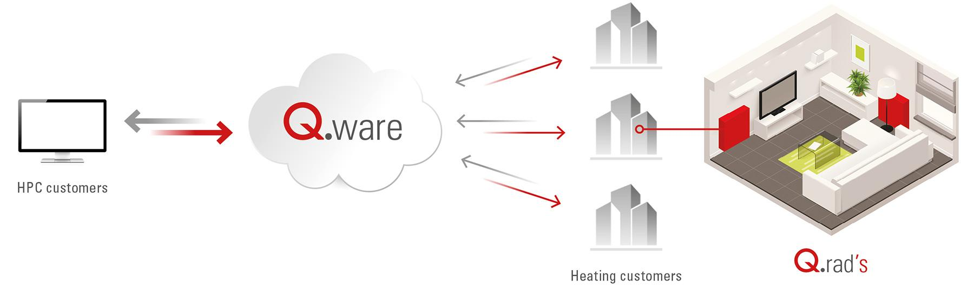
System Design
Fog computing service
Qarnot platform - practical fog computing
Fog nodes: Q.rad
Sensors: Present on Q.rad
Sensed/user data: Data collected from Q.rad sensors
Deploy customized Docker images on Q.rad
Orchestration using Qarnot API
Run our machine learning model on each fog node

Slide 11
System Design
Privacy-preserving machine learning
Goal
Build a machine learning model with relatively high accuracy
Prevent adversary restore raw data from intermediate result
Method
Train model locally first, then train data remotely in the cloud
Redefine loss function to add attacker and defender in loss function
Evaluation
Accuracy of the machine learning model (the higher the better)
Extent to which attacker can restore our raw data (the lower the better)
Overall performance of the system using this machine learning model

Slide 12
System Design
Privacy-preserving machine learning
θ1
y’
L₁ = L(y, y’; θ₁)
measure of accuracy of user’s model
L₂ = L(x, x’; θ₂)
measure of attacker’s success in reversing raw data
L₃ = - L(x, x’; θ_{1a})
measure defender’s success in defending against attacker
L = L₁ + L₂ + L₃
Ultimate loss function to optimize
θ_{1b}
θ_{1a}
cloud
θ2
Z
Z
local
Attacker
X
X’

Slide 13
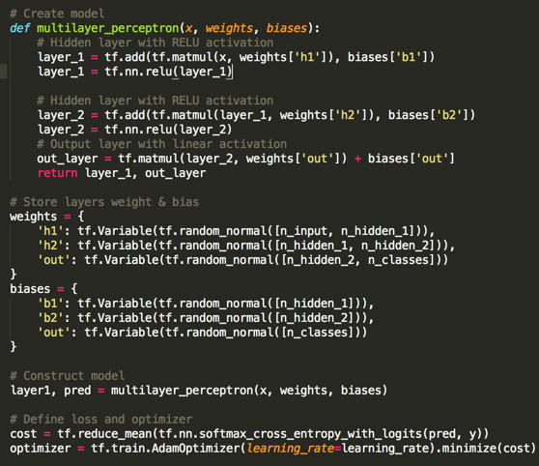
System Implementation - TensorFlow
Define neural network parameters
Parameter of layers
Weights
Bias
Loss function
Original model: cross entropy
Attacker & defender: mean square root
Optimizer
Adam Optimizer

Slide 14
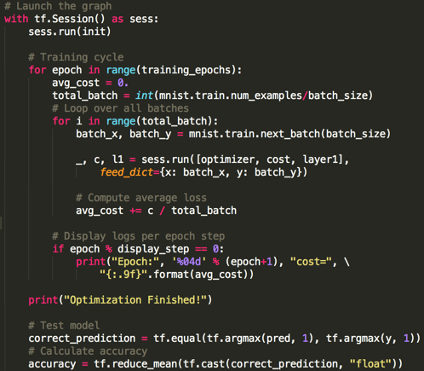
System Implementation - TensorFlow
Run training and evaluation process
Run training process in several iterations (epoch)
Feed training data to model in each iteration
Test model performance using test data

Slide 15
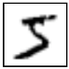
Experiments & Analysis
Goal
Prove our assumption: attacker is able to restore raw data and defender can defend against attacker
Find out elements that can affect the performance of attacker and defender
Design
Use case: MNIST handwritten digits classification
Run machine learning for 30 epochs with:
Output of 1 layer VS Output of 2 layers
Attacker only VS Attacker + defender
For each epoch, record: test accuracy, validation accuracy, cost of attacker
Evaluation
Test accuracy: accuracy of the machine learning model
Cost of attacker: attacker’s success in reversing raw data
5

Slide 16
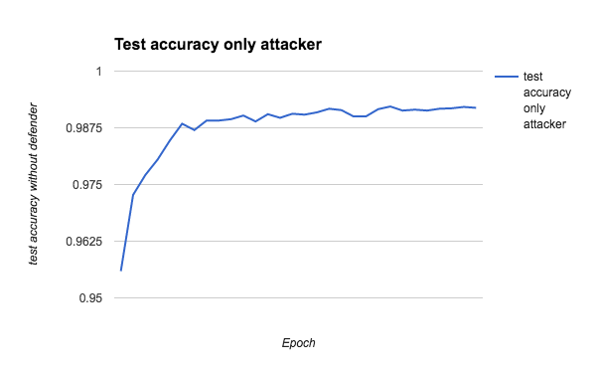
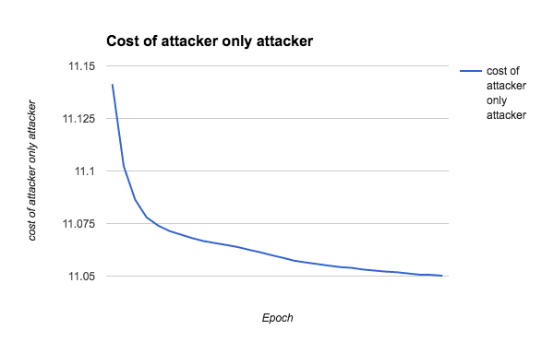
Experiment 1: 1 Layer - Attacker Only
Result
Analysis
The original model can still reach relatively high accuracy with the presence of attacker
Attacker is able to lower its cost and potentially restore raw data

Slide 17
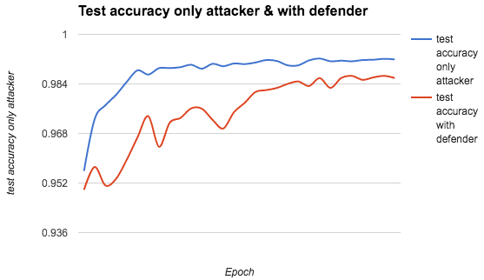
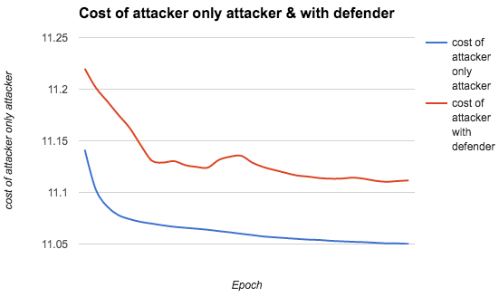
Experiment 2: 1 Layer - Attacker + Defender
Result
Analysis
Adding defender will increase cost of attacker -> defend against attacker from restoring raw data
Adding defender will also decrease the test accuracy -> trade off of protection

Slide 18
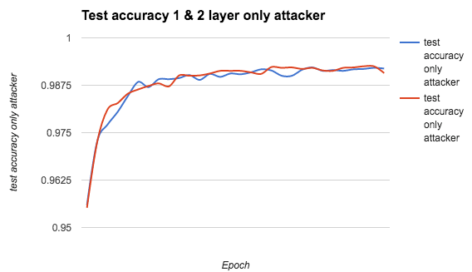
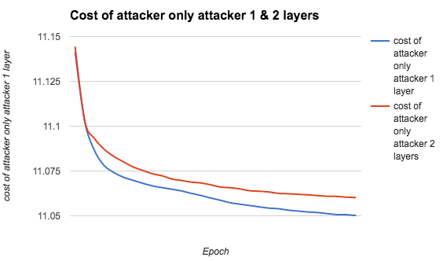
Experiment 3: 2 Layer - Attacker Only
Result
Analysis
Use output of 2 layers will not have evident influence on the test accuracy
Use output of 2 layers will increase cost of attacker -> make it more difficult for attacker to restore data

Slide 19
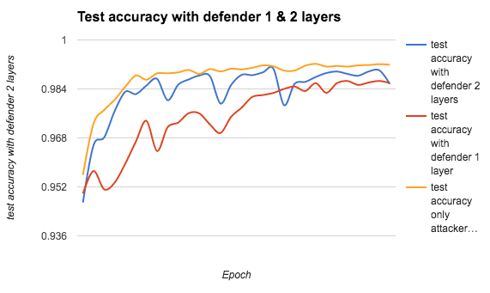
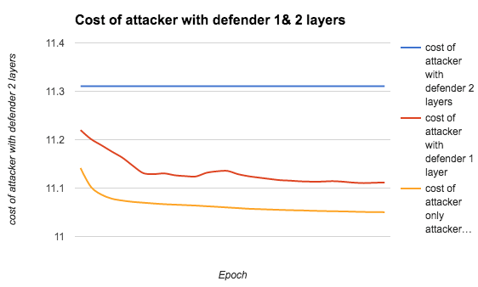
Experiment 4: 2 Layer - Attacker + Defender
Result
Analysis
The defender with 2 layers will not decrease test accuracy compared with 1 layer
But can further increase cost of attacker -> stronger protection

Slide 20
Overall analysis
Conclusions
Attacker is able to decrease cost during training process -> potentially restore raw training data
Presence of defender can increase attacker’s cost -> protect against attacker
Use the output of more layers will increase attacker’s cost -> make it harder for attacker to restore raw data
Defender with more layers can further increase attacker’s cost -> better protection against attacker
Limitations
Attacker is not strong enough -> only one layer
A stronger attacker will be developed in future work

Slide 21

Extended project goal
Street View House Numbers Classification
Dataset
MNIST-like 32-by-32 images centered around a single character
Dataset is obtained from house numbers in Google Street View images
Implementation
Parameters of layers - weights and biases
Loss - cross entropy loss + weight decay terms
Optimizer - GradientDescentOptimizer
Evaluation
94.5% accuracy with 100000 steps and 350 epochs
Obtained accuracy is more than the benchmark from Shokri Paper (93%)

Slide 22
Extended project goal
Street View House Numbers Classification
Attacker + Defender model
Work in progress
Need a stronger attacker model than MNIST
SVHN classification is a computationally intensive and rigorous training model compared to MNIST

Slide 23
System Design
Query processing and substitution
Input
.wav
Speech-Text
CMU-Sphinx
Natural Language Processing
Core-NLP
Create additional Queries
Output
Filter Results for User Query Result
Send Queries to the Server

Slide 24
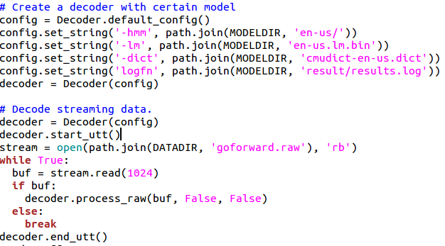
System Implementation - CMU Sphinx
Create a configuration Object
Decode the file stream
Initialise ngram search
Obtain recognition result

Slide 25
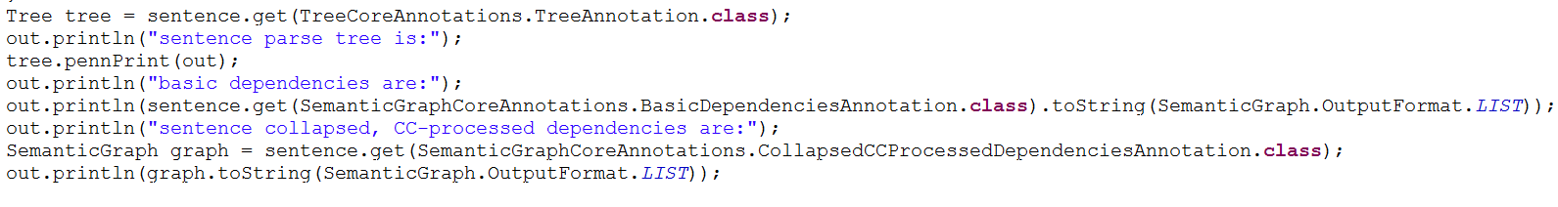
System Implementation - CoreNLP
Define Annotators for the sentence
Run selected annotators on the text
Access annotations and get the parse tree

Slide 26
Conclusion
Harder for an attacker to retrieve the original image (input data)
Adding attacker-defender model results in lower overall accuracy, but satisfactory results
Query model makes it harder, but not impossible, to determine the user query
Query model results in an overall system overhead

Slide 27
Future Work
Develop a stronger attacker and evaluate performance
Extend to other image/video/speech based applications
Deploying the model on Qarnot platform and test the full-fledged data sharing service
Evaluate overall system performance
Build models with higher accuracy and lower overhead

Slide 28

Questions?

